Slide 1
The potential for increased primary energy efficiency and reduced CO₂ emissions by district heating and cooling
Markus Alsbjer, Markus Lindahl
Energy Technology
SP Technical Research Institute of Sweden
Toronto 2011-06-28

Slide 2



The project group
SP Technical Research Institute of Sweden, Sweden
Project leader
KDHC - Korea District Heating Technology Research Institute, South Korea
SINTEF Energy Research, Norway

Slide 3
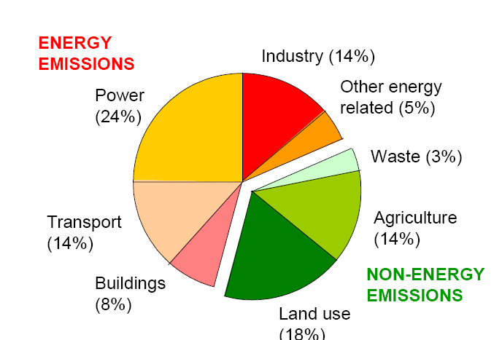
Background to the project
A central standard for calculating the “energy performance” is EN 15603 where two main indicators are suggested:
  Use of primary energy
  Emissions of green house gases
The idea of the project is to develop a method which can be used to calculate emissions of CO₂-eq and PEF for relevant production chains of district heating and cooling
Focus on combined heat and power (CHP) plants

Slide 4
Aim and objective
Aim: To illustrate the environmental potential of saving primary energy and reduce the impact on global warming by the use of district heating and cooling
Objective: To develop a method for calculations of greenhouse gas emissions and use of primary energy for the total production chain of district heat and cold to buildings.

Slide 5
The main steps of the project
Analyse actual process chains for district heating and cooling
Analyse actual CHP plants
Develop a method for calculating the environmental performance of the district heating and cooling production chains
Case studies

Slide 6
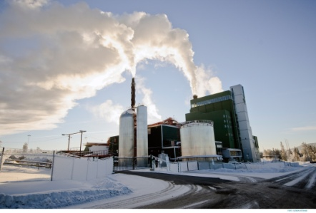
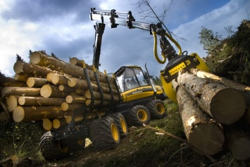
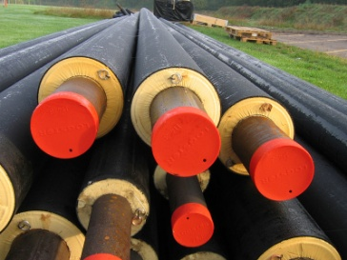


Introduction to Life Cycle Assessments (LCA)
Calculates emissions and use of resources from all parts of a products life cycle
  Extraction of resources – Production – Use – Waste handling
The principles for LCA calculations are defined in the ISO standards 14040 and 14044
All emissions and use of resources are related to the functional unit

Slide 7
System boundaries

Slide 8
Background calculations
An Life Cycle Assessment (LCA) approach have been used
  Including all parts of the life cycle until the heat/cold is delivered to the building
The functional unit is 1 kWh of delivered heat or cold to the building
Included impact categories:
  Global warming potential, GWP (g CO₂-eqvivalents/kWh delivered energy)
  Primary Energy Factor, PEF (kWh primary energy/ kWh delivered energy)

Slide 9
Allocation methods in marginal and average scenarios
Two scenarios have been identified in this project:
Marginal scenario
  Studying the effects of a change in the system
Average/bookkeeping scenario
  Bookkeeping purposes or historical reporting
The allocation method describes how emissions and recourses are shared between the heat and electricity in the CHP-plant
  Depending on the scenario the choice of allocation methods will differ
Emissions
Electricity
Resources
District heating

Slide 10
Marginal scenario
Often used for:
  Studying the effects of a change in the system.
Typical questions for the marginal scenario:
  What production will be affected if you turn out the light?
  What will be the environmental effects of heating a new residential area?
The marginal production is the technology/fuel that will be affected if the consumption of heat or electricity is changed.
  Normally the technology with the highest production cost
In this project coal power plants is considered as the marginal production for electricity

Slide 11
Marginal perspective of an electricity system
Electricity system
PE: 10 units
3 units elec
4 units DH
PE: 20 units
5 units elec
15 units elec
4 units DH
PE: 20 units
5 units elec
PE: 8 units
PE: 20 units
2 units elec
5 units elec
Sum PE: 58 units
Sum PE: 60 units
(PE = Primary energy)

Slide 12
Allocation method for CHP-plants, marginal scenario
The power bonus method is chosen for allocations with the marginal perspective
PE_{heat} = PE_{total_CHP} – PE_{alt_elec_prod}
PE_{elec} = PE_{alt_elec_prod}
PE_{heat} = 10 – (3*4) = -2 units
PE_{elec} = 3*4 = 12 units
3 units elec
PE_{total CHP}: 10 units
4 units DH
PE_{alt} _{elec} _{prod}: 12 units
3 units elec
(PE = Primary energy)

Slide 13
Average/Bookkeeping scenario
Often used for:
Bookkeeping purposes
Historical reporting
Typical questions for the average scenario:
  How much greenhouse gases has my consumption of district heating caused this year?
  How many percent of the greenhouse gas emission within EU are related to the district heating sector?

Slide 14
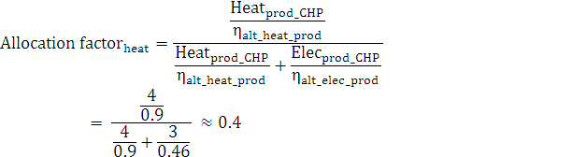
Allocation method, average scenario
The alternative generation method is chosen for allocations with the average perspective
Emissions and resources is allocated to the heat and power production in proportion to the fuel needed to produce the same amount of heat or power in two separate plants.
Both the heat and the power production benefits from the use of the CHP process
3 units elec
PE_{total CHP}: 10 units
4 units DH
Power bonus method
PE_{elec} ≈ 6 units (PE_{elec} = 12 units)
PE_{heat} ≈ 4 units (PE_{heat} = -2 units)

Slide 15
Computer simulations
Sensitivity analysis of CHP-plant related to the choice of:
  Supply temperature
  Return temperature
  Power to heat ratio
Sensitivity analysis of ABS-chiller related to the choice of:
  Supply temperature
  Return temperature

Slide 16
Computer simulations of natural gas CHP-plant
- Heat and Power efficiency as a function of the supply temperature

Slide 17
Case studies
Study the choice of allocation method
Study the choice of fuel
  CHP-plants
  Heat only plants
Study the dominance analyse of the production chain
Study the choice of size of the plant
Study district cooling with absorption chiller

Slide 18
Greenhouse gas emissions
- Depending on fuel, production technology and allocation method

Slide 19
Use of primary energy
- Depending on fuel, production technology and allocation method

Slide 20
Greenhouse gas emissions
- Dominance analyse district heating, Average scenario

Slide 21
Greenhouse gas emissions
- Dominance analyse district heating, Average scenario

Slide 22
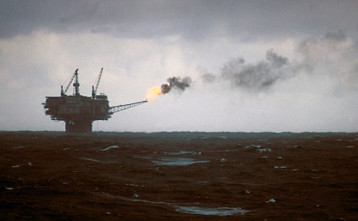
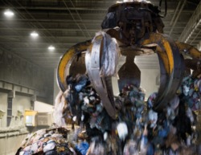
Main conclusions
A method for calculations of the “environmental performance” for the production chain of DH/DC has been developed
The choice of allocation method has an enormous impact on the final results
With a marginal scenario, natural gas is the best choice of fuel
With an average scenario waste or biomass is the best choice
The impact related to additives are significant to the final result

Slide 23
Future work
There is a need for better documented and more transparent data for different energy chains.
Data for different fuels listed in EN 15603 are very general and might give misleading values for DHC.
Calculations of PEF and CO₂-eq including all parameters is time-consuming. There is a need for a simplified method and/or a computer based calculation tool that enables calculations for different energy chains
The choice of allocation method has a great impact on the final result. An analysis of additional allocation methods briefly described in this project would be of interest.

