Slide 1

Interaction Between District Energy and Future Buildings; Distributed Solar Systems
Thomas Onno
Gagest Inc
June 28, 2011

Slide 2
IEA CONTRACTS:
  Interaction Between District Energy and Future Buildings that have Storage and Intermittent Surplus Energy
Distributed Solar Systems Interfaced to a District Heating System that has Seasonal Storage

Slide 3
Objectives
Prototype Space Heating/DHW System
Maximize Use of Cogeneration Waste Heat
DSM in Low-Energy Houses
Privately Owned Solar Systems
  Direct Sales via Utility
  Sales via Borehole Seasonal Storage

Slide 4
Low – Energy Buildings
  Characteristics of Low-Energy Buildings
    Space Heating 8,000 kWh/yr; DHW 4,000 kWh/yr
    Low Energy Density = 0.55 – 0.65 MWh/m.yr
    Requires Optimized Subdivision Layout
  Methods to Minimize Fossil Fuel Usage
    Low Temperature Space Heating
    Low Cost - Load Shedding
    Medium Cost - Off Peak Storage for DHW
    Active Storage for Space Heating
    Solar - with and without Seasonal Storage

Slide 5
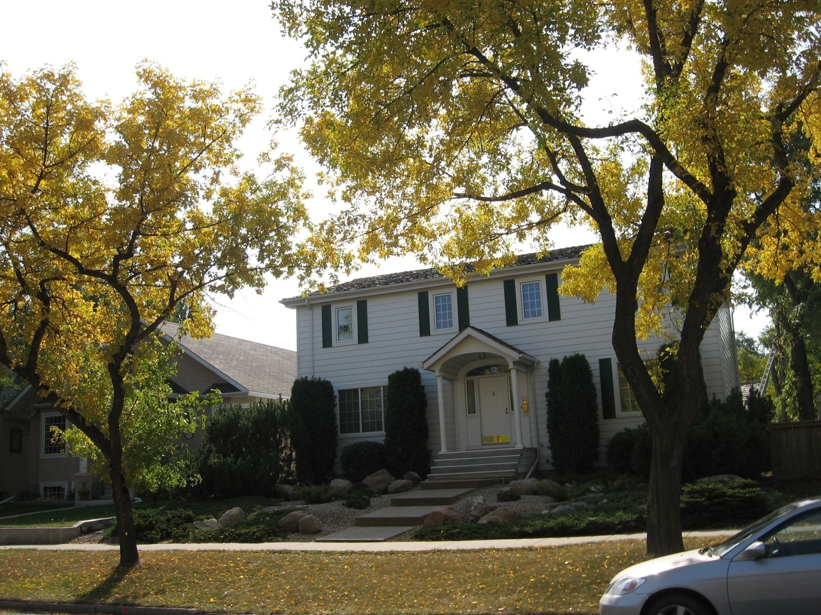

Slide 6
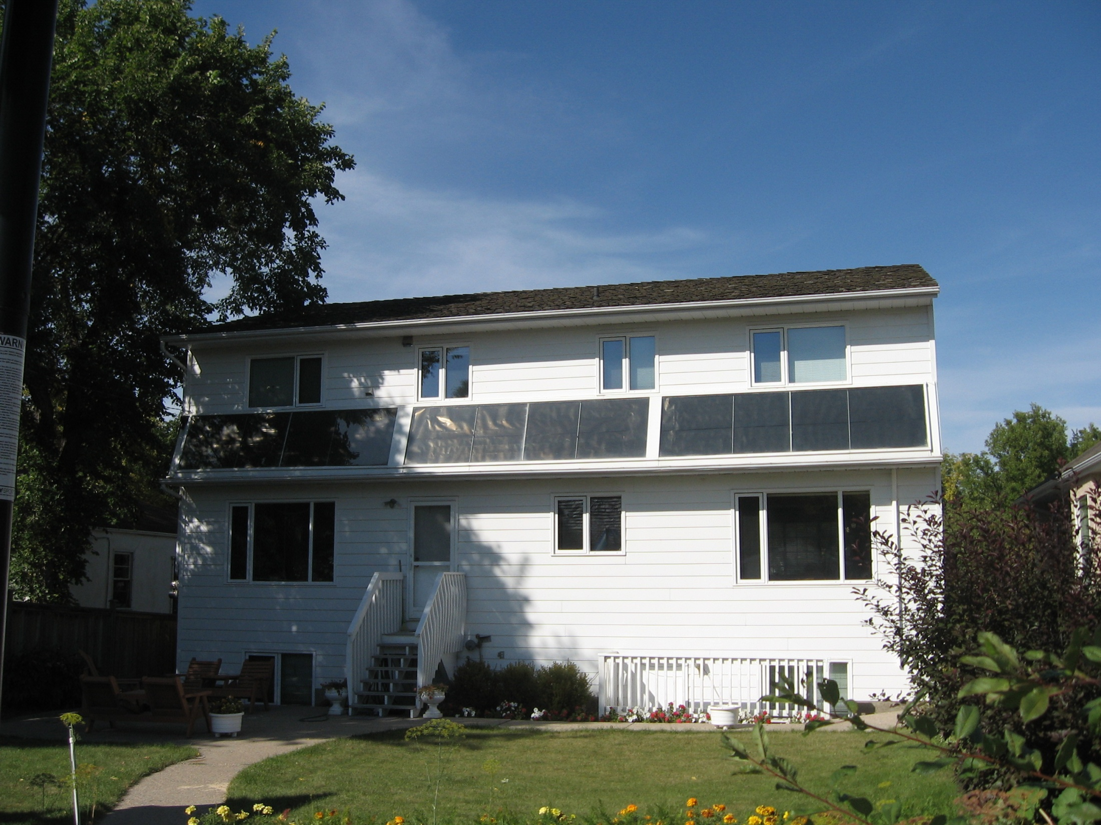
Solar Collectors 15.6 m²
4,000 Litre Storage
25

Slide 7
Loss in Temperature with No Space Heat (Tin-Tout normalized to 40°C)

Slide 8
Transient Characteristics of Dumont House
(Tin-Tout normalized to 40°C)

Slide 9
Temperature Drop in Dumont House
(Tin-Tout Normalized to 40°C)

Slide 10
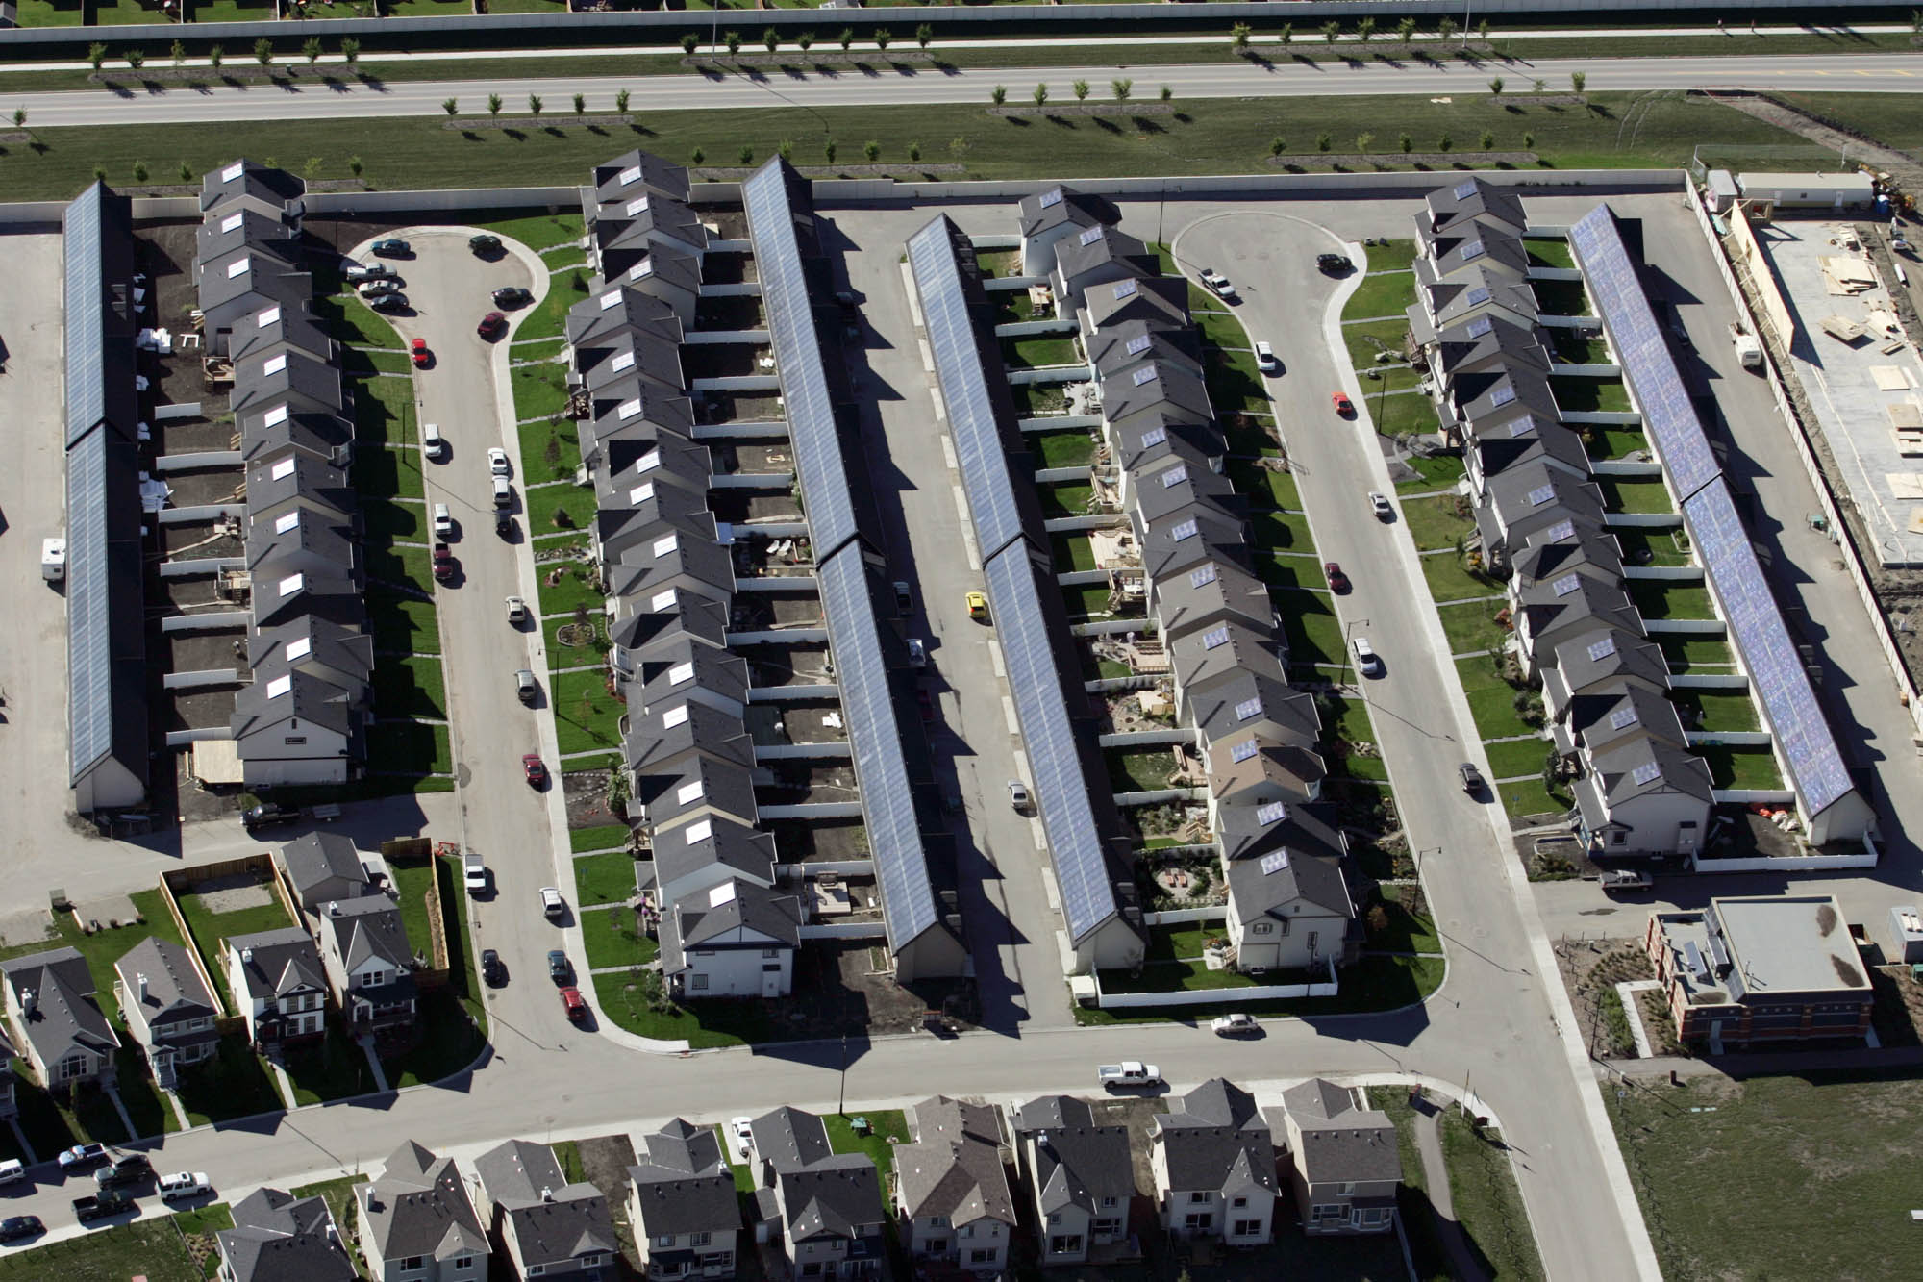
Drake Landing Solar Community Housing Layout in Okotoks, Alberta
Natural Resources Canada: CanmetENERGY

Slide 11
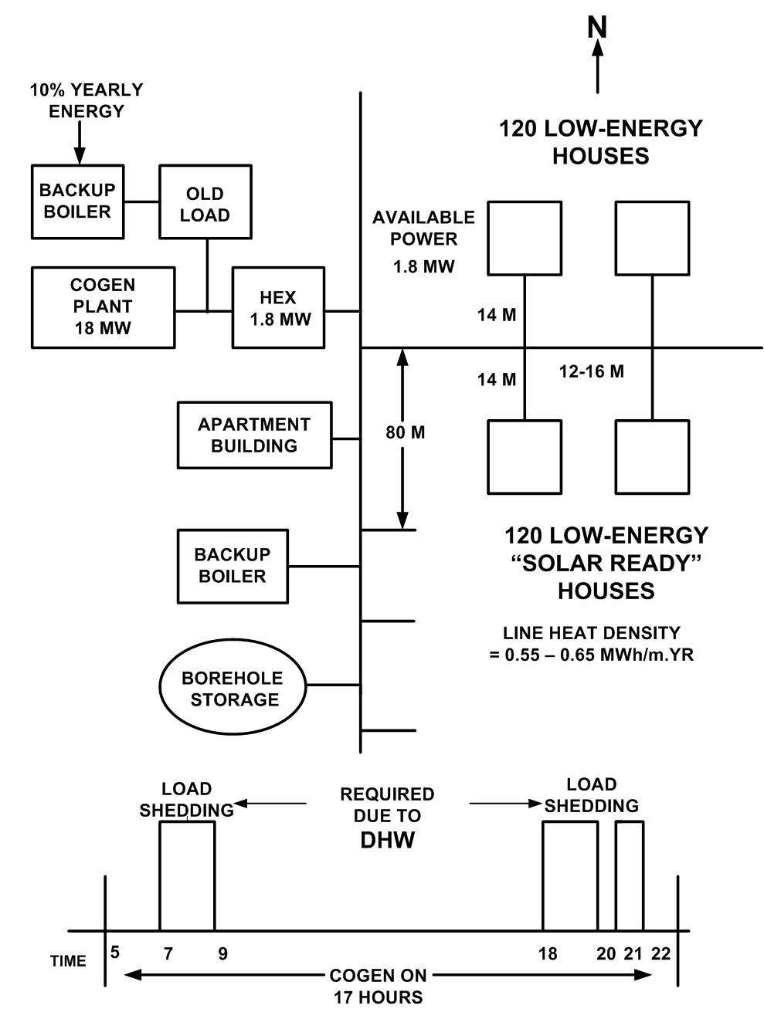
Future Subdivision Layout

Slide 12
Space Heating System with Single Row Air Coils
6.5 kW at 65 Deg C Supply
170 litres / hr

Slide 13
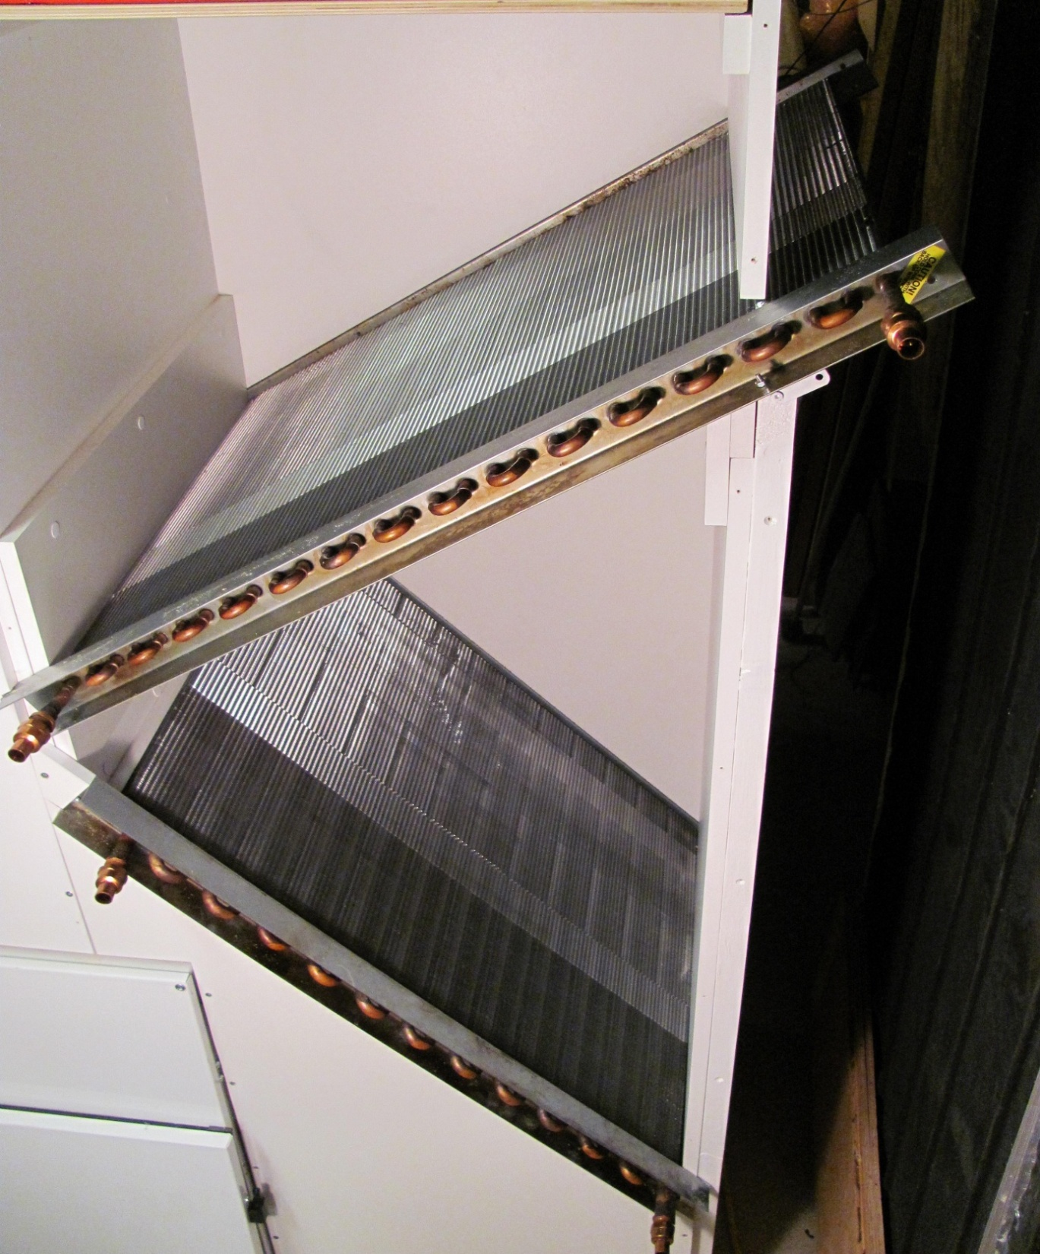
Air Coil Configuration
Top Right End Protrusion Connects To Ventilation Preheat

Slide 14
Effect of Ventilation Air Temperature on Water Return Temperature

Slide 15
Non-Solar House with DHW Tank System

Slide 16
Cases, Load Shedding Initiated when Backup Boiler is Needed
Case 1: Basic Substation, Constant Temperature
Cases 2, 2.1, 2 NSB: Drop Temperature up to 0.7 Deg C
      Preheat by 1.0 Deg C, Drop by 2.0 Deg C at Night
Cases 3, 3.1,3 NSB: Same as 2, + Double Thermal Capacity
Cases 4, 4.1, 4 NSB: Same as 3, with 280 litre DHW Tank

Slide 17
Cases with 10% Old System Boiler (Okotoks Weather)

Slide 18
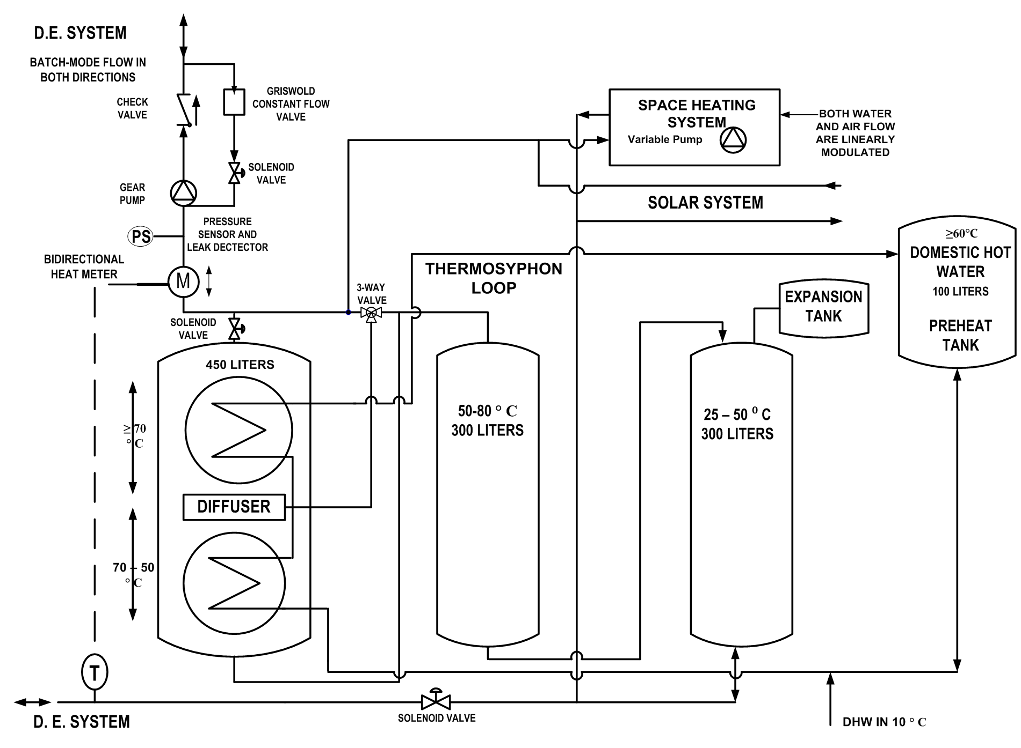
House Heating System Layout

Slide 19
Stratification Performance of Three Tank Systems at 178 Litres/Hour

Slide 20
DHW Tank Recovery from 23°C

Slide 21
Performance of 10 Collector Array

Slide 22
Solar Energy Sold to Non-Solar Houses

Slide 23
Heat Costs Cents/kWh (20 Yr) (Okotoks Weather)
CASE | 1 | 2 | 2.1 | 2 NSB | 3 | 3.1 | 3NSB | 4 | 4.1 | 4NSB
c/kWh | 5.47 | 5.22 | 5.00 | 5.06 | 5.00 | 4.84 | 4.86 | 4.57 | 4.51 | 4.50
To Recover Incremental Solar Cost
Case 6: Branch Line In 4.00 c/kWh ( + $8500)
Plus Branch Line 5.15 c/kWh ( + $2450)
Total Cost (Utility + Private)
Case 7: 20 Yr 17.9 c/kWh
30 Yr 15.1 c/kWh

Slide 24
Conclusions (Okotoks Weather)
Low-Energy Houses are well suited to DSM
DHW Storage Tanks are Effective for DSM
DSM Lowers Energy Cost: 5.47 – 4.5 c/kWh
Privately-Owned Solar:
  Direct – 4.00 – 5.15 c/kWh up to 9% energy
  Via Borehole Seasonal Storage:
    17.9 c/kWh(20 yr): 15.1 c/kWh (30 yr)

